Slide 1
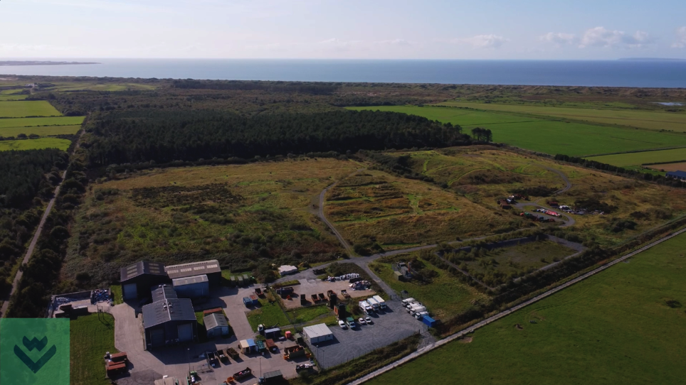

Restoring nature on old landfill sites

Slide 2
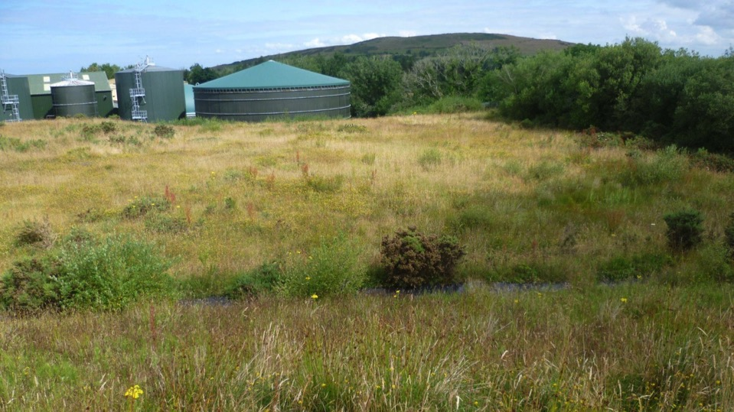
Nature
Habitat
Biodiversity
Recycle
Habitat creation
Waste

Slide 3
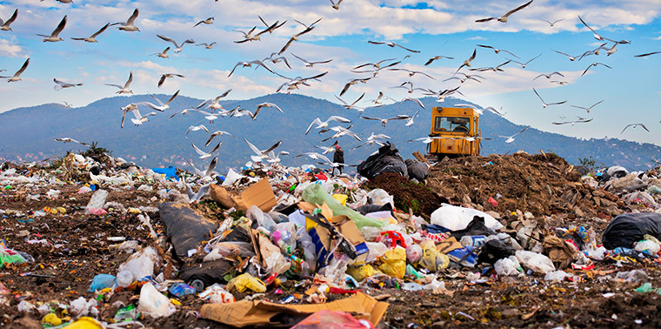
What is landfill?
A place where we bury household waste in the ground

Slide 4

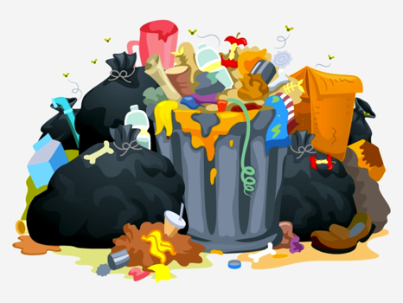
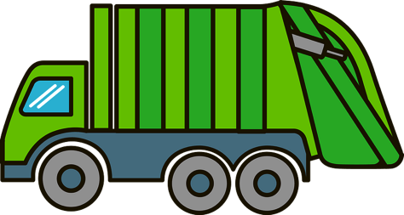
What goes in it?

Slide 5
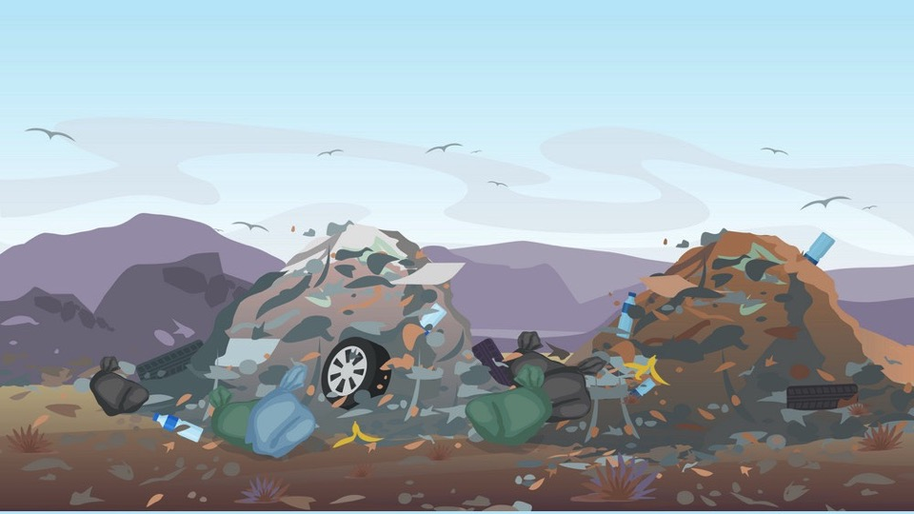
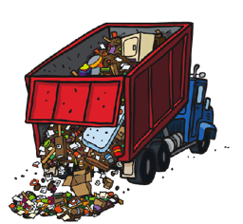
Landfill

Slide 6
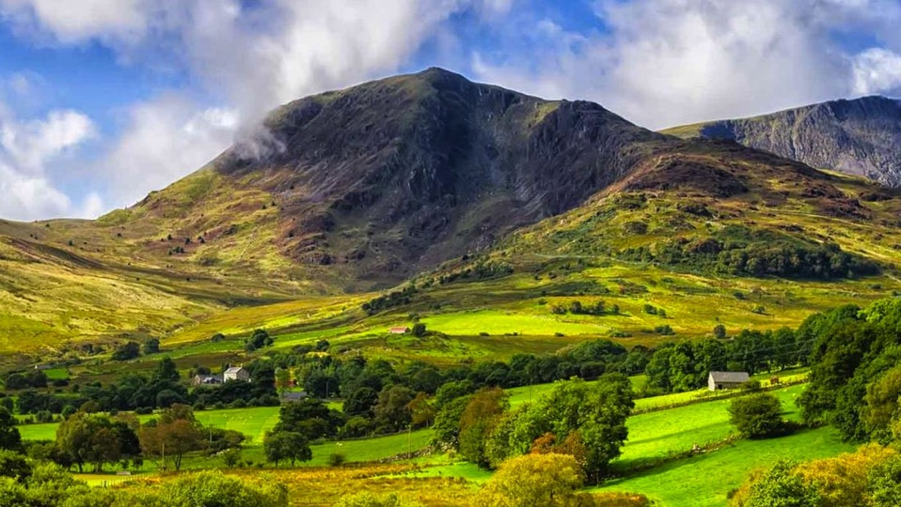
Where does the landfill site come from?
Forests
Meadows
Rivers
A home for nature
Habitats
Biodiversity

Slide 7
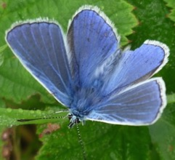
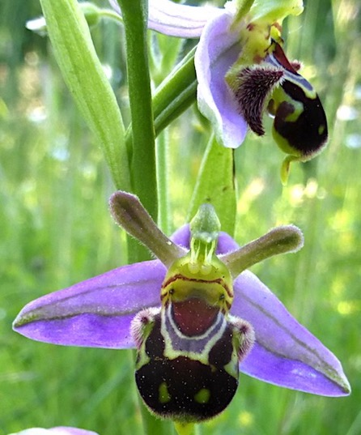
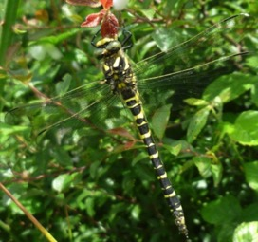
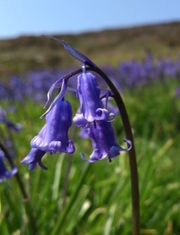
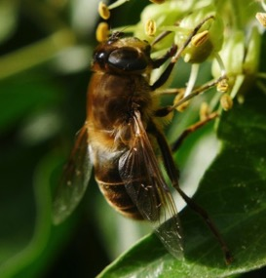

Slide 8
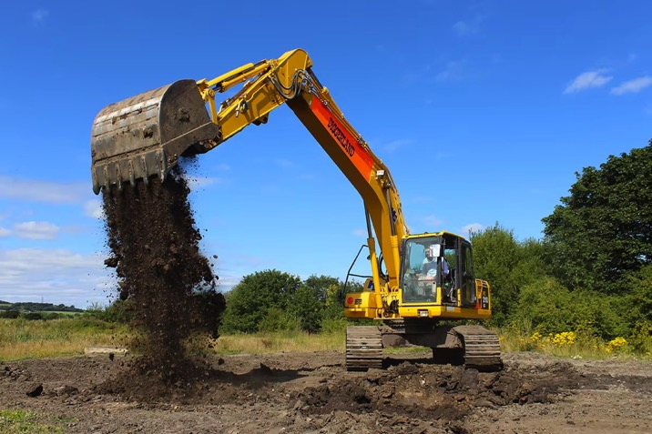
Now dig your hole!

Slide 9
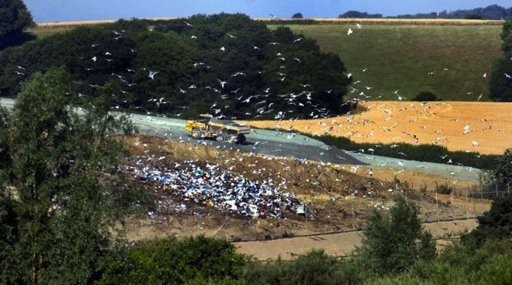
And start to fill it with household waste……

Slide 10
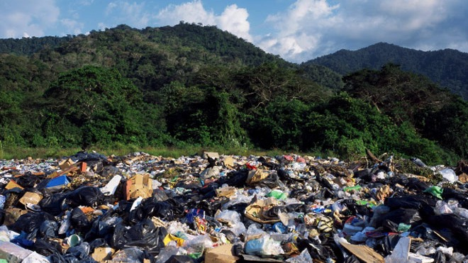
Until it’s full…….

Slide 11
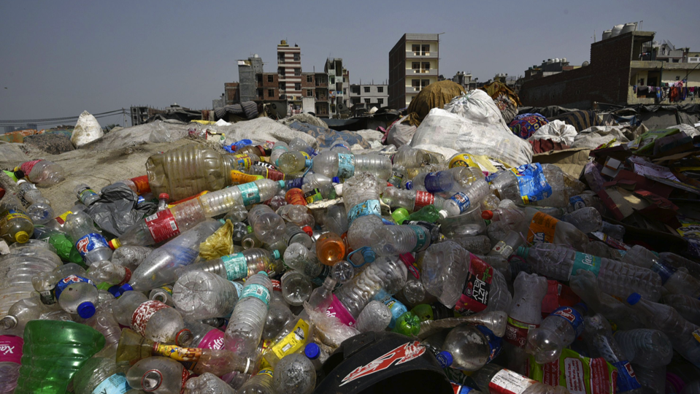
How long does it take to breakdown household waste?
100 years
200 years
400 years
Plastic bottles

Slide 12
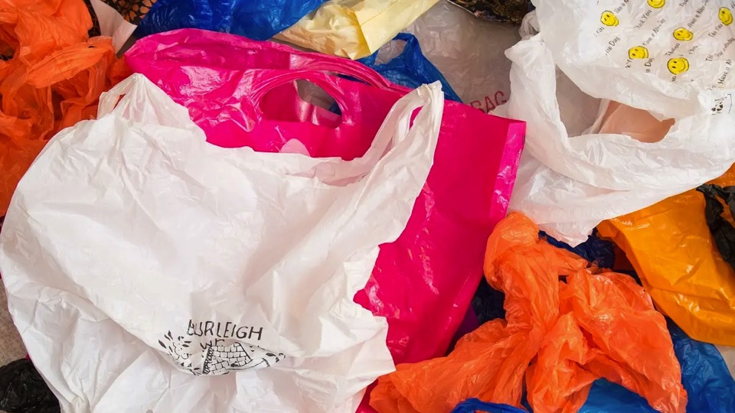
Plastic bags
500 years
800 years
1000 years

Slide 13
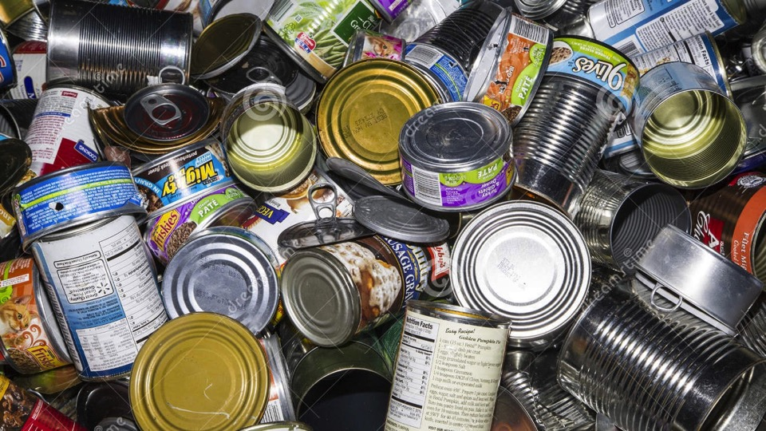
Tin cans
30 years
50 years
90 years

Slide 14
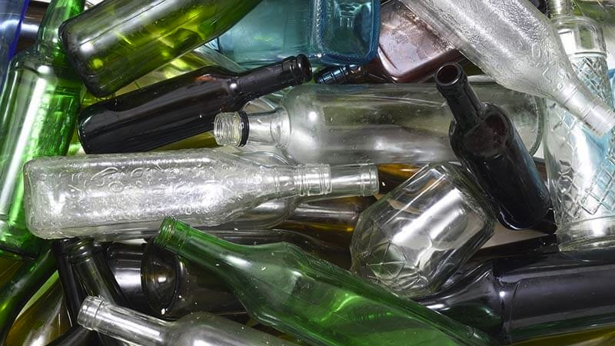
Glass
100,000 years
200,000 years
1,000,000 years

Slide 15
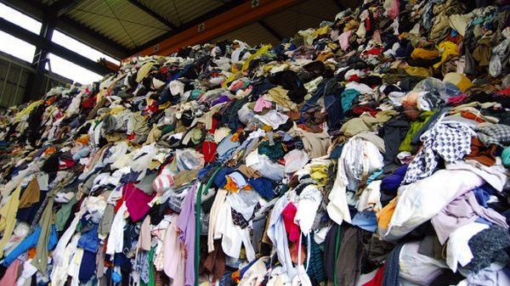
Clothes
1 month
3 months
5 months

Slide 16
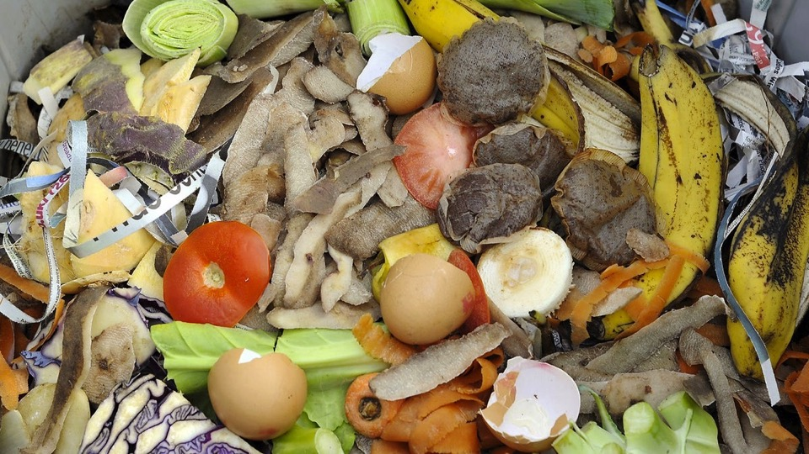
Food waste
1 week
1 month
2 months

Slide 17


So what can we do to reduce what goes into landfill?
Reduce packaging
Sort our waste
Consume less
Repair items

Slide 18
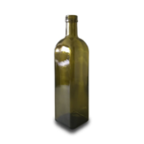

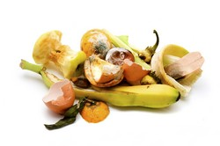





Recycling Sort this pile of rubbish!

Slide 19

Something we can all do……..

Slide 20
Can nature return to this old landfill site?

Slide 21
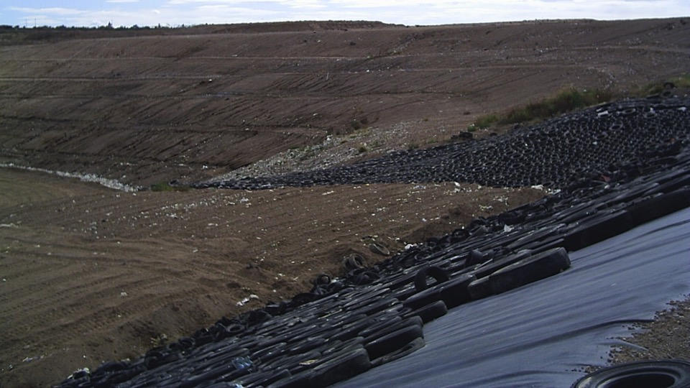
But first…… containing the waste and cap with soil

Slide 22
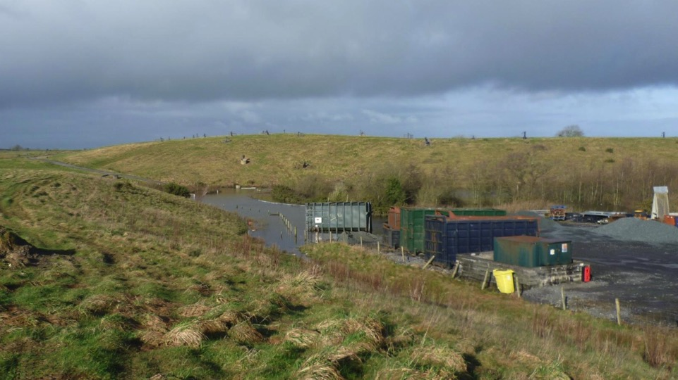

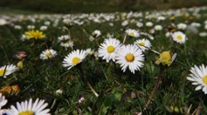
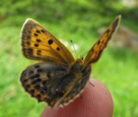
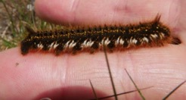
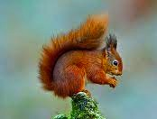
Will nature just return to this location?

Slide 23
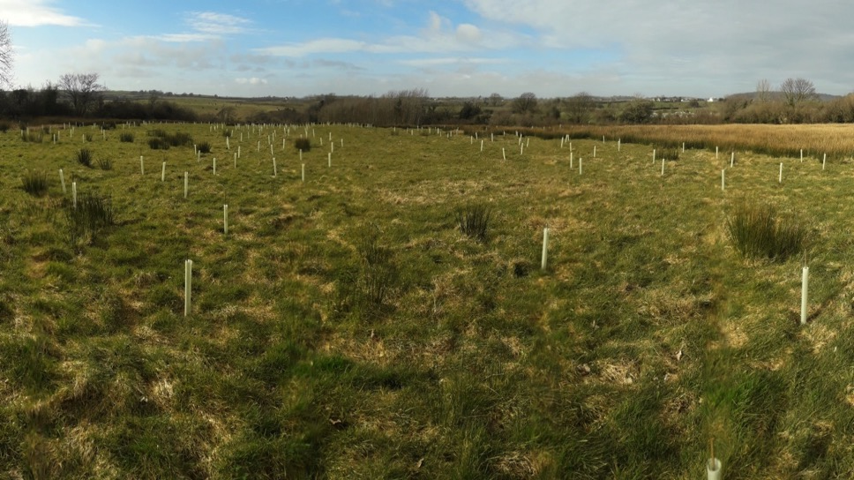
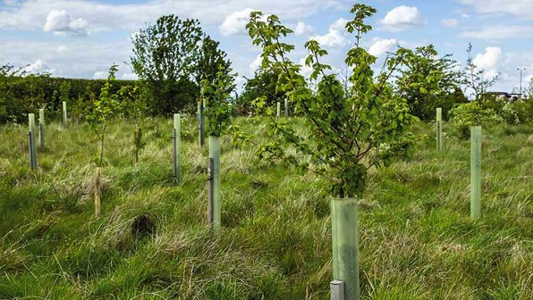
We can give nature a helping hand

Slide 24
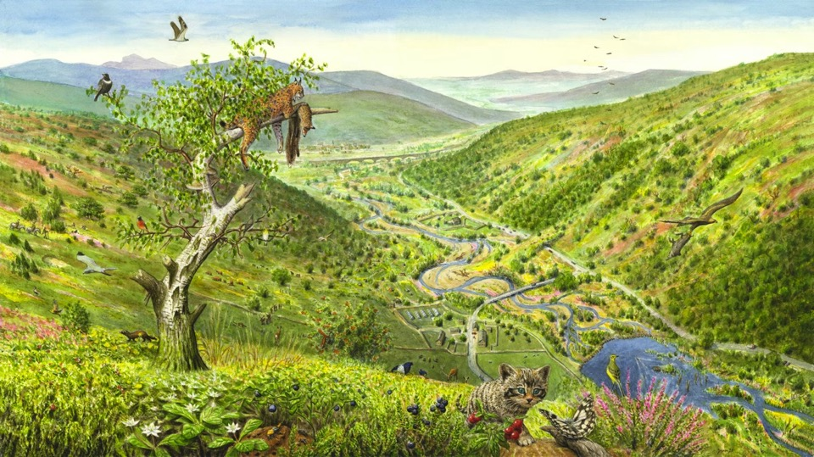
Can we restore it back to what it was like before?
We call this wilding or recreating habitats

Slide 25
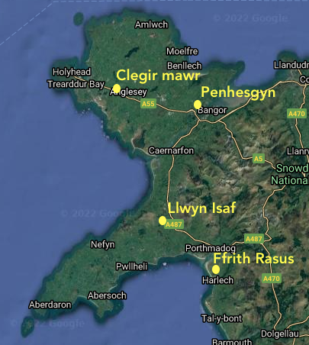
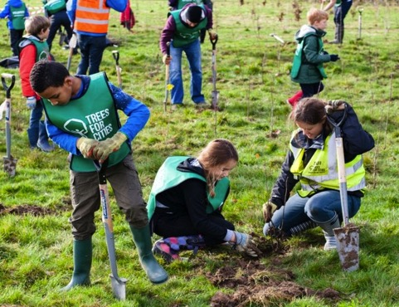
There are 4 landfill sites in north Wales being restored to nature

Slide 26
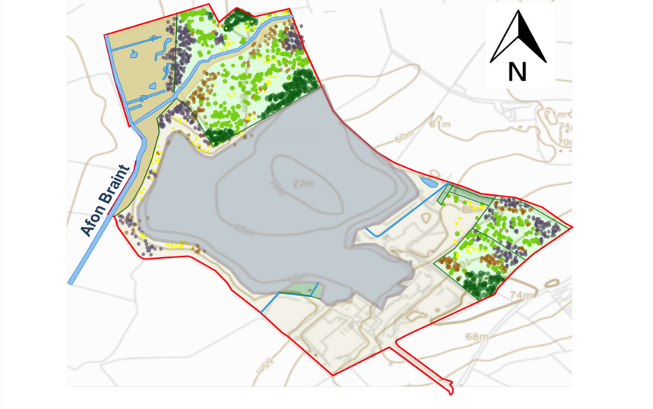
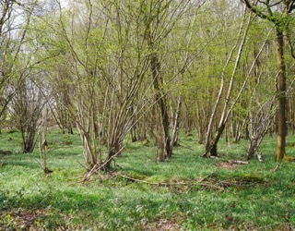
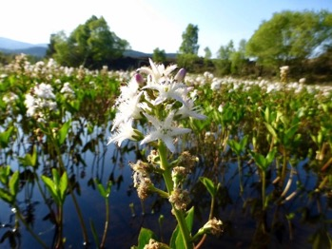
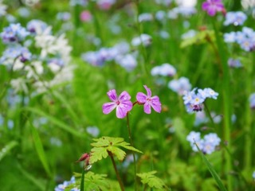
Designing the new habitats

Slide 27

Where do you fit in?
Join the school Eco council
Start reducing household waste
Do a school ground survey - STEM
Create a habitat at school
Share your experiences on social media #greenrevolution

