Slide 1
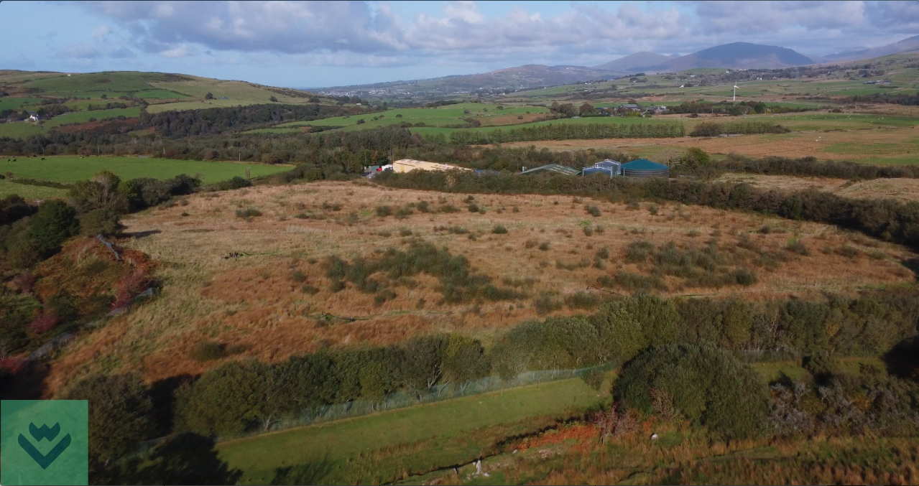
Activity: Create a habitat map
Using Llwyn Isaf landfill site in Gwynedd, create your own habitat map for this site.
There is a blank habitat map for each site along with reference materials.
Use the habitat cards and species cards to help design the habitats
You can also create food chains and webs from the species cards as an extension activity
The following slides are to give background

Slide 2
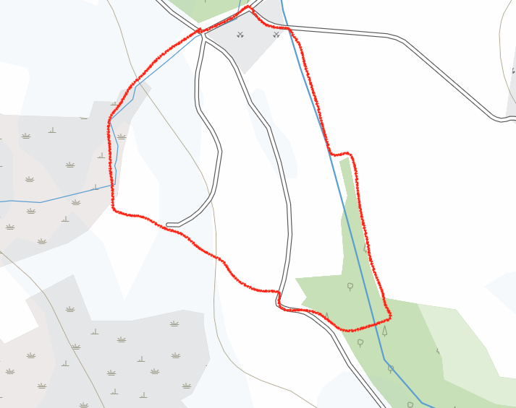
Activity: Create a habitat map at Llwyn isaf
Steps:
Create a key for the different habitats
Mark the map using the colours of the key (feel free to use your own ideas here)
Use the habitat cards to see what species live in each habitat
Use the species cards to design a habitat map
Key to habitats
Existing woodland
New woodland
New wildflower meadow
New wetland habitat
New pond creation

Slide 3
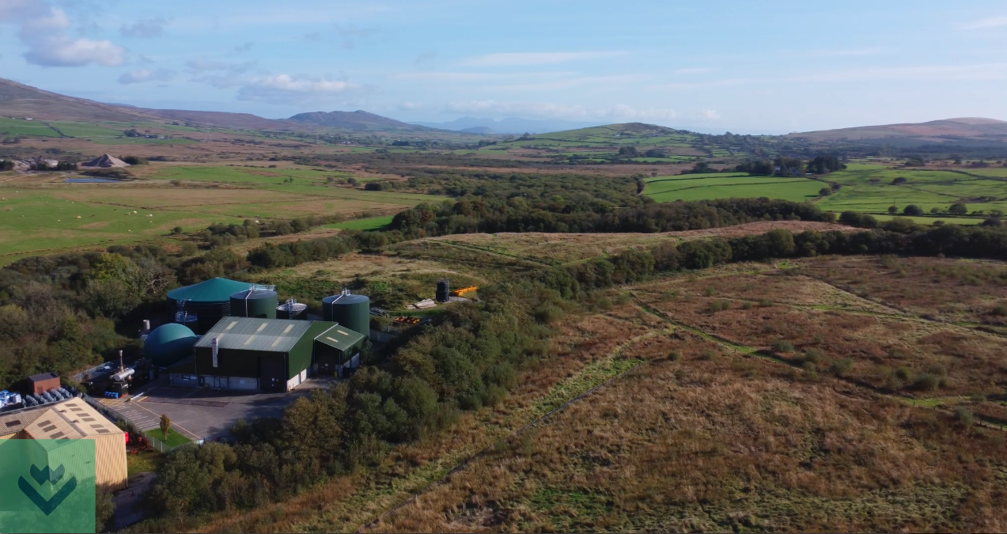
Llwyn isaf

Slide 4
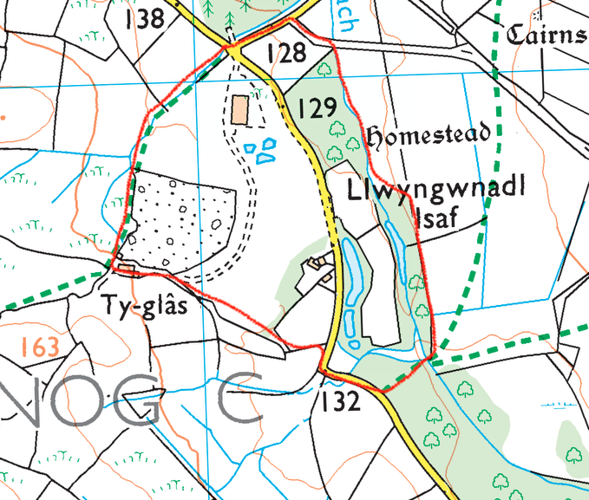
Llwyn isaf - Ordnance survey map (reference material)
Can you identify the different habitats on the map i.e. grassland, woods, wet areas?

Slide 5
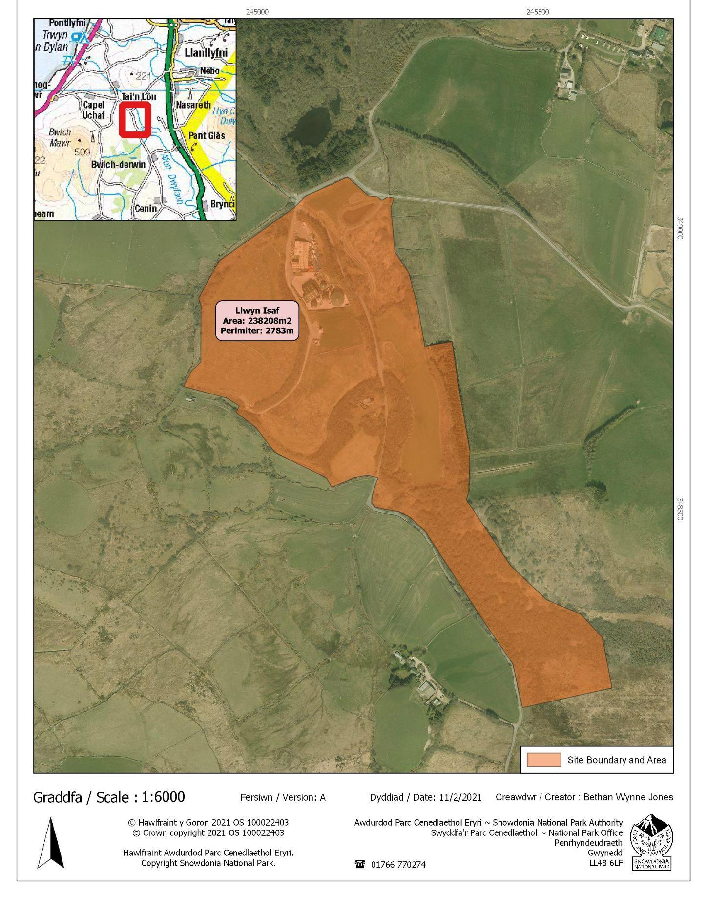
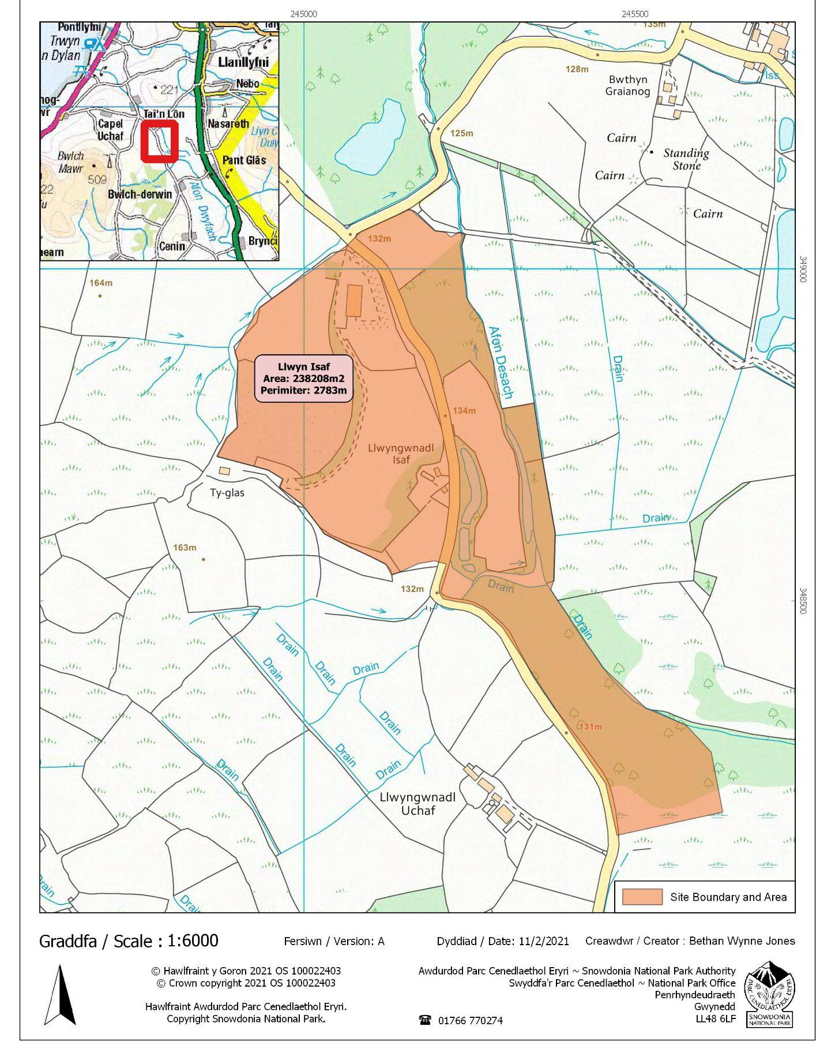
Llwyn isaf - disused landfill site (reference material)

Slide 6
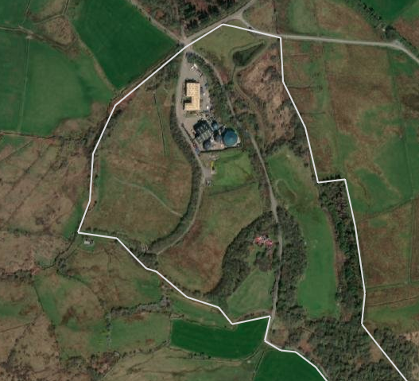
Llwyn isaf - satellite image (reference material)

Slide 7
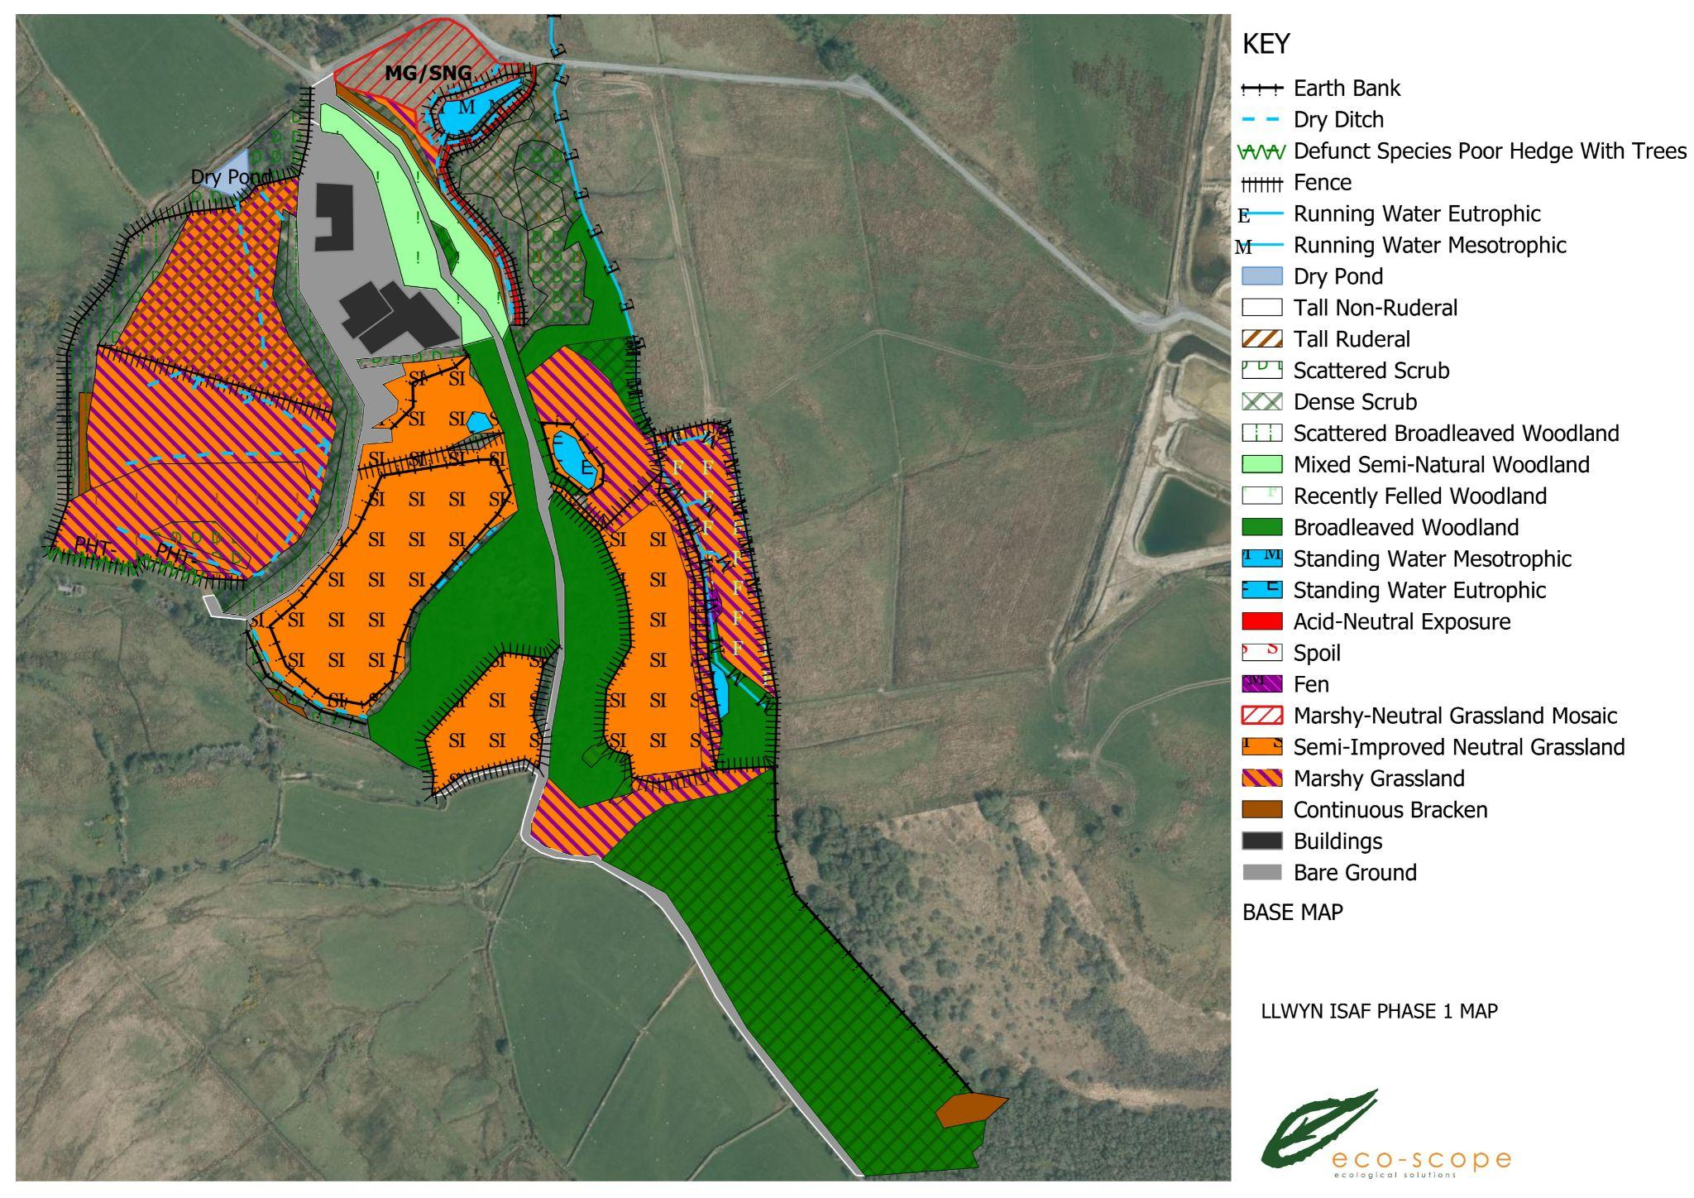
Llwyn isaf - official GIS map with new habitats (for reference)

