Slide 1
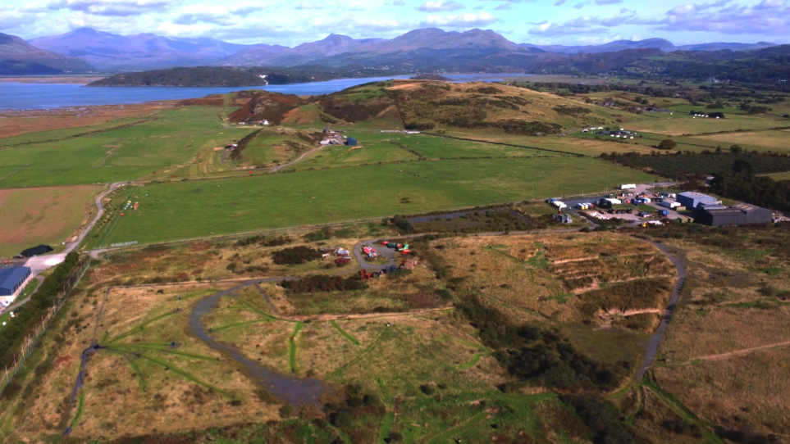
Restoring nature on old landfill sites

Slide 2
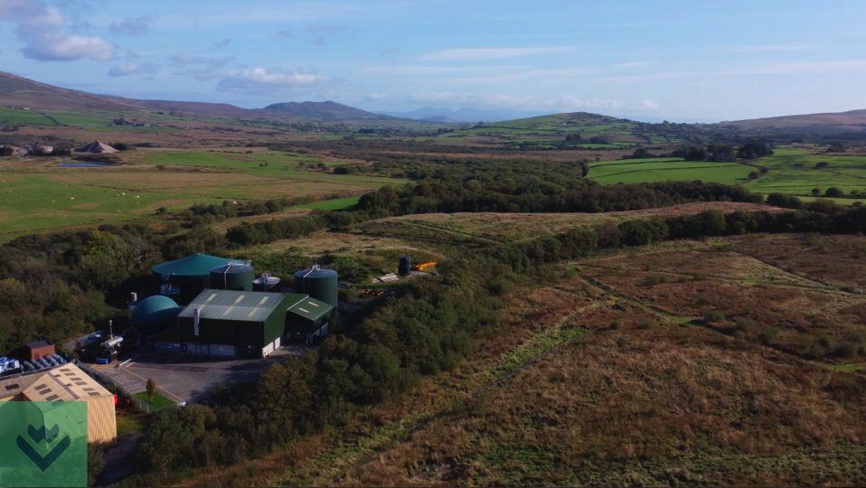
Aim of the project:
Wild Landfill is an NRW multi-agency project to begin the reversal of this trend incorporating all aspects of Sustainable Management of Natural Resources into its brief.
The major issue
The legacy of industry and waste disposal is one of nature loss and pollution of the natural environment. Degrading land and soils and reducing biodiversity in the natural environment and the soil.

Slide 3
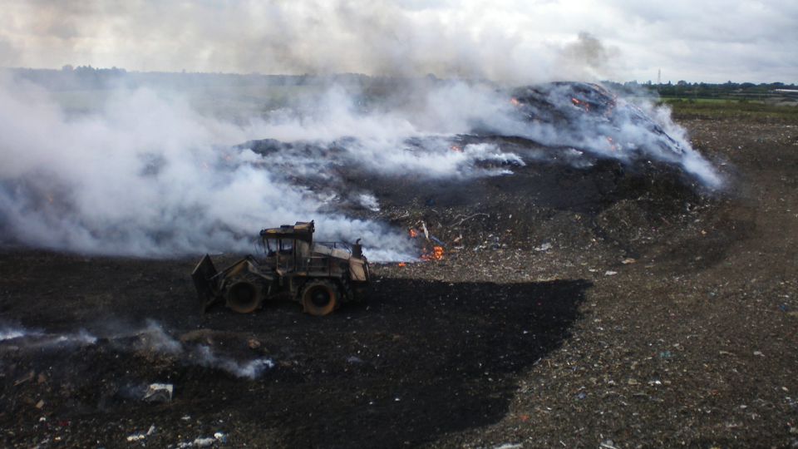
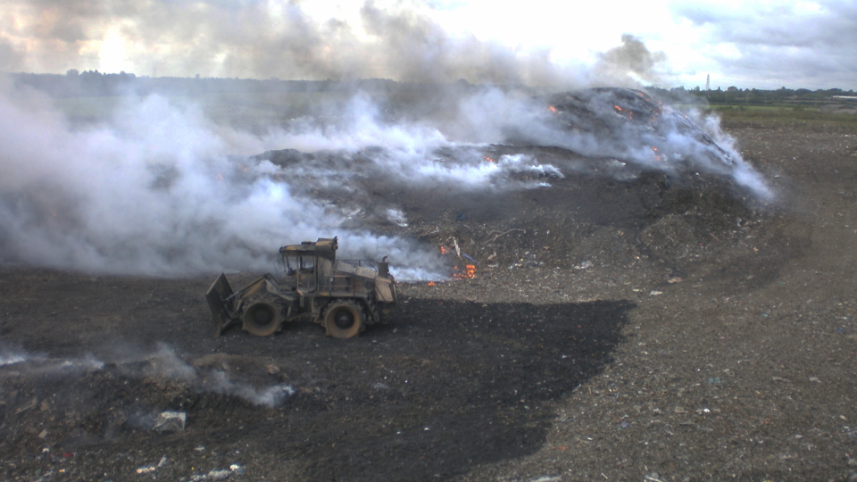
How bad can it be?
Landfills are where we dump of our waste
The world generates 2.01 billion tonnes of municipal solid waste annually
Globally, we're producing a colossal 1.3 billion tons of landfill waste annually, with a projected increase to 2.2 billion tons by 2025.
The average person in the UK throws away around 400kg of waste each year; 7 times their body weight. Of the 26m tonnes of waste produced in the UK 14 million tonnes are sent to landfill
How can we reduce our waste footprint?

Slide 4
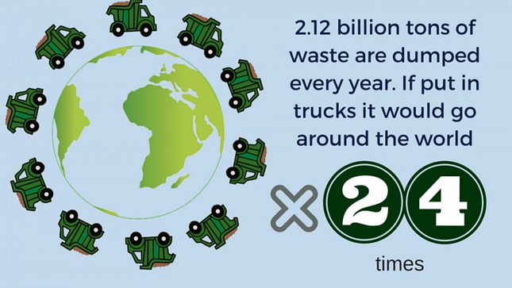
How much landfill waste is generated per year?
https://visual.ly/community/Infographics/environment/shocking-facts-about-waste

Slide 5
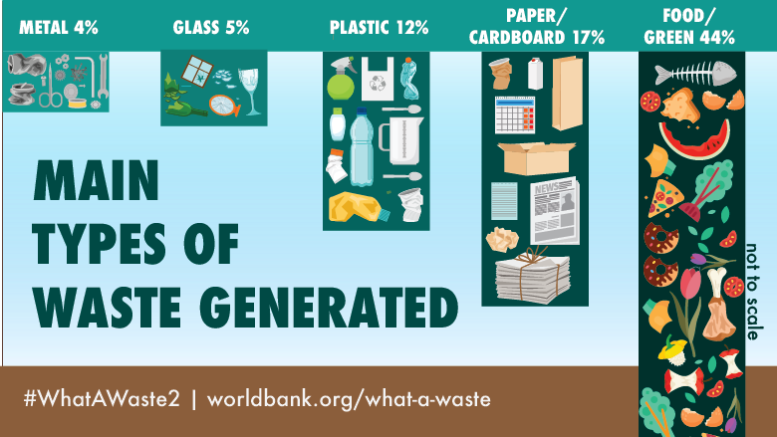
What waste types end up in landfill
https://www.worldbank.org/en/news/infographic/2018/09/20/what-a-waste-20-a-global-snapshot-of-solid-waste-management-to-2050

Slide 6
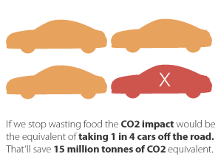
What if we reduce our waste heading for landfill?
https://en.wikipedia.org/wiki/Food_waste_in_the_United_Kingdom

Slide 7
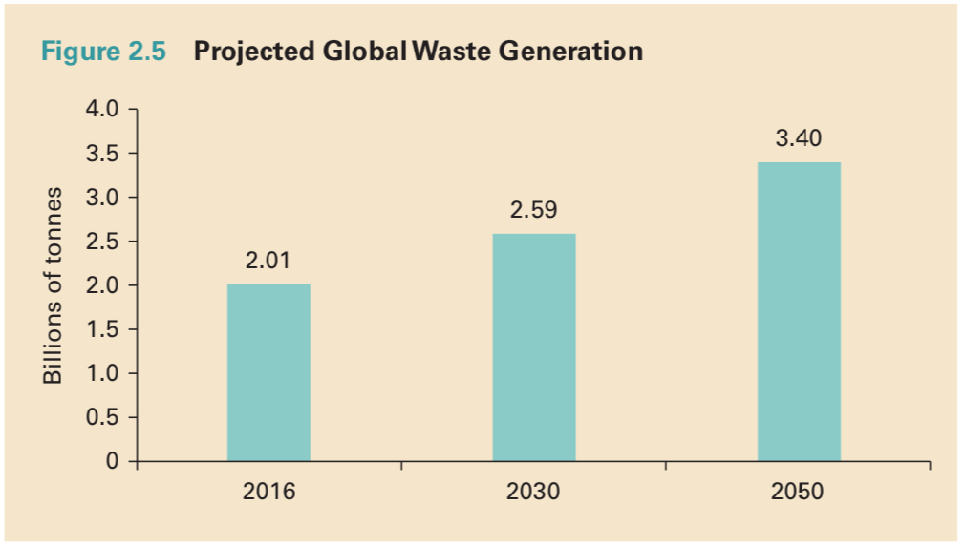
https://openknowledge.worldbank.org/handle/10986/30317

Slide 8
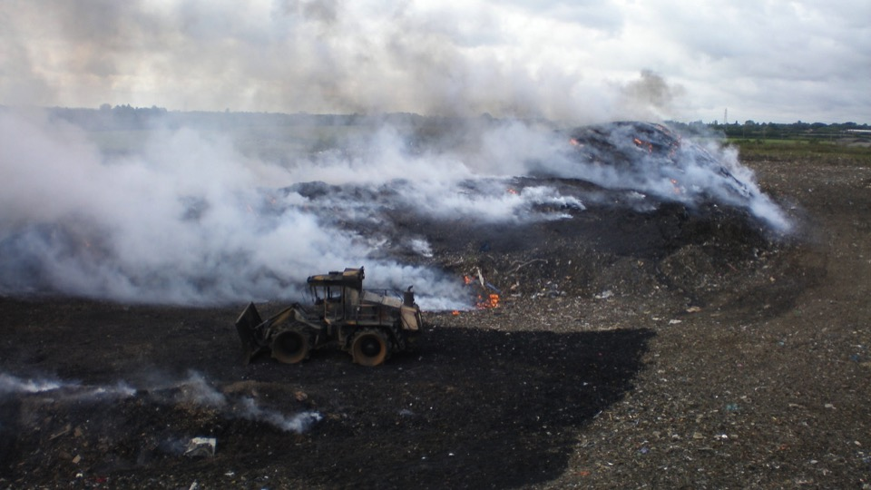
What happens when landfills are full and disused?
How can we create a new habitat?
What is required to create a new habitat?

Slide 9
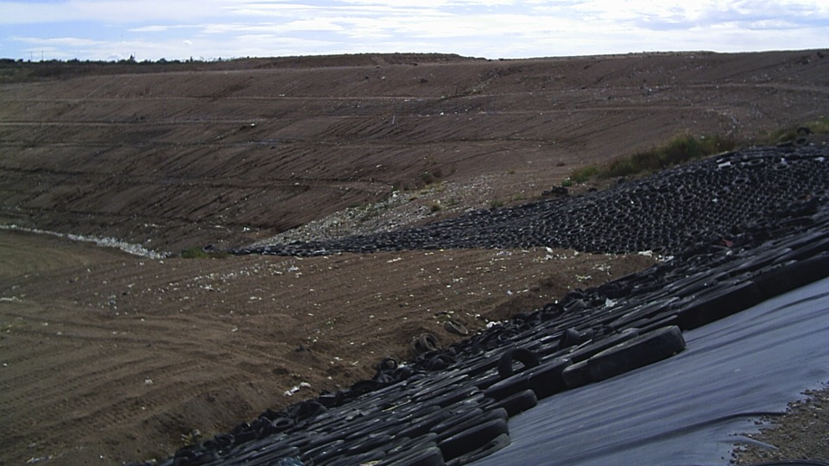
They get capped and lined to contain the contaminated waste and to prevent any pollution leaching out

Slide 10
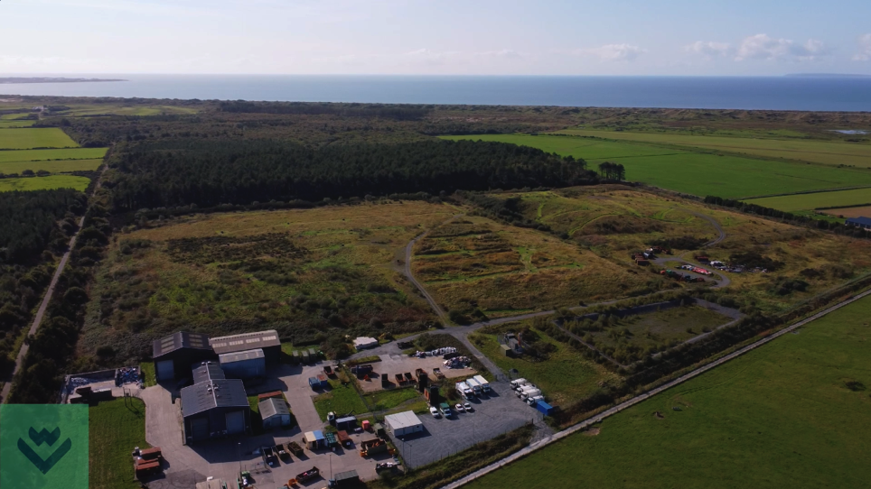
Ffrith rasus - disused landfill site at Harlech

Slide 11
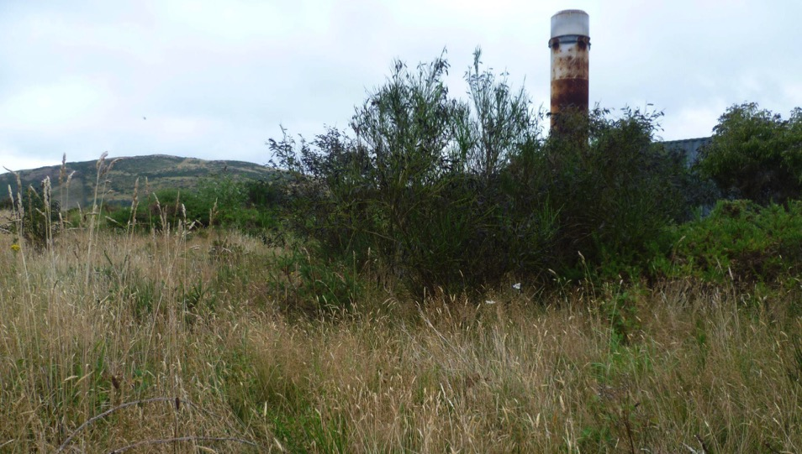
Can we utilise landfill and surrounding land for nature recovery and climate change action?

Slide 12
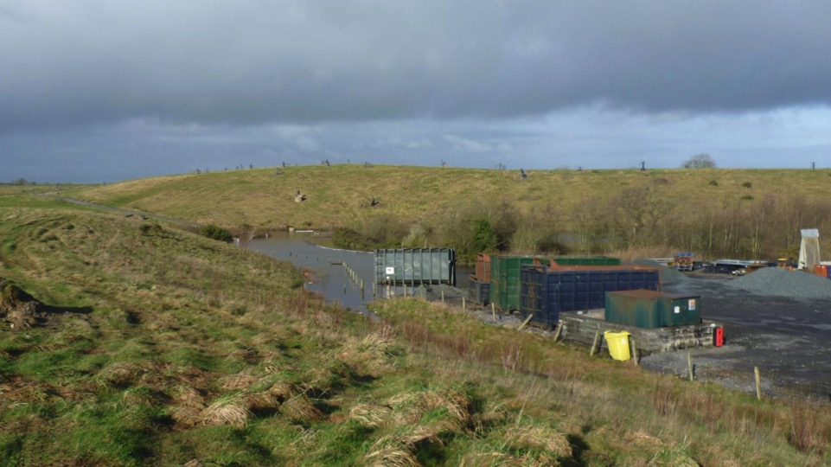
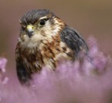
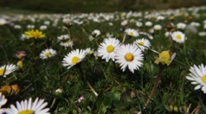
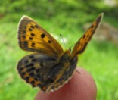
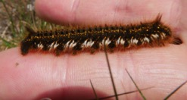
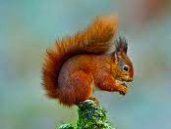
Can nature return to disused landfill sites?

Slide 13
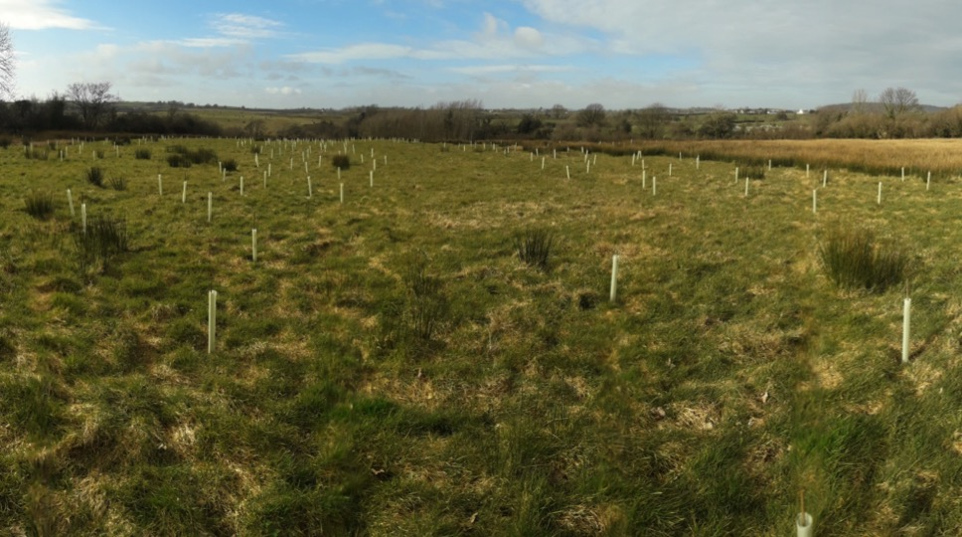
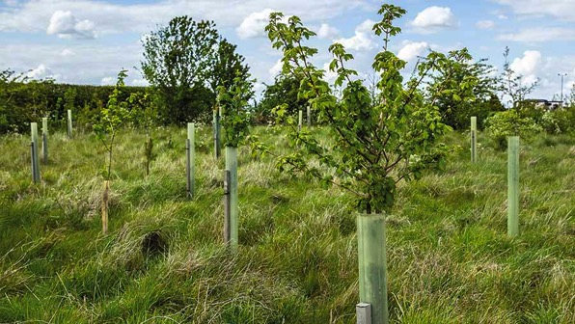
We can give nature a helping hand

Slide 14
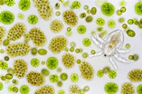
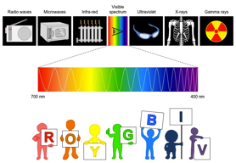
Visible light
99% lost or not used by leaves
1% used by leaves through photosynthesis
Electromagnetic radiation
Green leaves
Phytoplankton

Slide 15
Energy flow

Slide 16
Ecological Pyramids
Why does the number of organisms decrease as you go up the trophic levels?
TERTIARY CONSUMERS
As you go up the trophic levels the energy of organisms decrease and their size gets bigger
SECONDARY CONSUMERS
PRIMARY CONSUMERS
PRODUCERS
Energy is lost between trophic levels

Slide 17
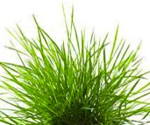
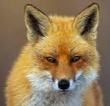
Flow and loss of energy
99% not trapped by plants
90% lost
90% lost
1,000,000 kJ (sunlight)
Grass
10,000 kJ
(i.e. 1%)
Rabbit
1000 kJ
Fox
100 kJ

Slide 18
Representing energy within food chains
TERTIARY CONSUMERS
(top carnivores)
Transfer of energy - WORST OF ALL
SECONDARY CONSUMERS
(carnivores)
Energy lost as heat due to metabolism e.g. respiration, excretion
Transfer of energy - EVEN LOWER
PRIMARY CONSUMERS
(herbivores)
Transfer of energy - LOWER
PRODUCERS
(green plants)
Transfer of energy - POOR
SOLAR ENERGY

Slide 19
Nutrient cycling
Organic material in
CONSUMERS
(heterotrophs)
Feeding
Breakdown of organic material by
Organic material
PRODUCERS
(autotrophs)
DECOMPOSERS
(heterotrophs)
Inorganic material in the
Photosynthesis & chemosynthesis
ABIOTIC (Non-living)
ENVIRONMENT
(Soil & water)

Slide 20
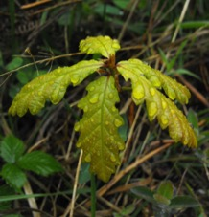
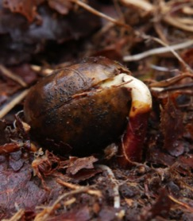
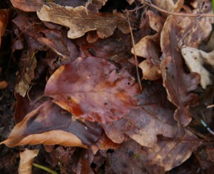
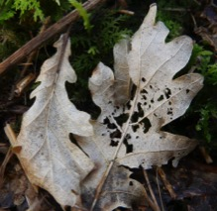
Nutrient cycle

Slide 21
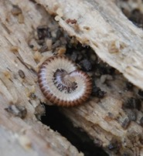
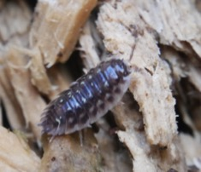
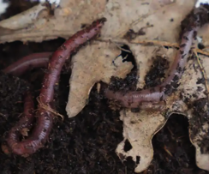
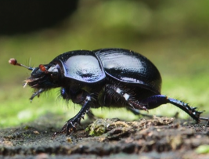
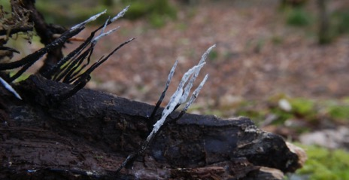
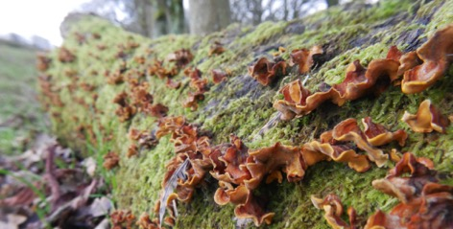
Nature’s recyclers
Detritivores - animals (internal digestion) that eat dead & decaying organic matter
Decomposers / saprotrophs (external digestion)- digest (rot) dead organic matter

Slide 22
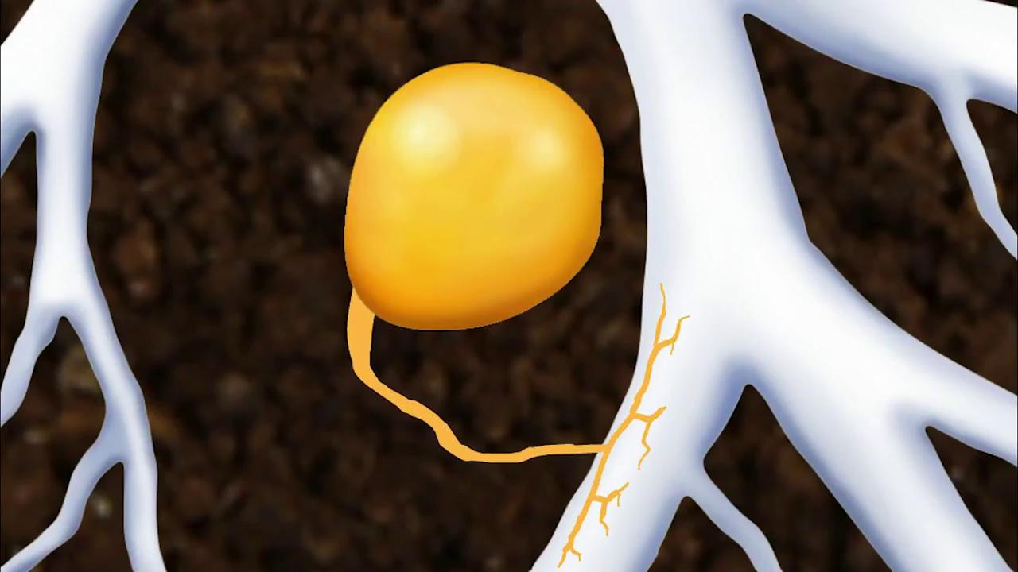
How do trees communicate?
https://www.youtube.com/watch?v=0oyqPZJj-2w

Slide 23
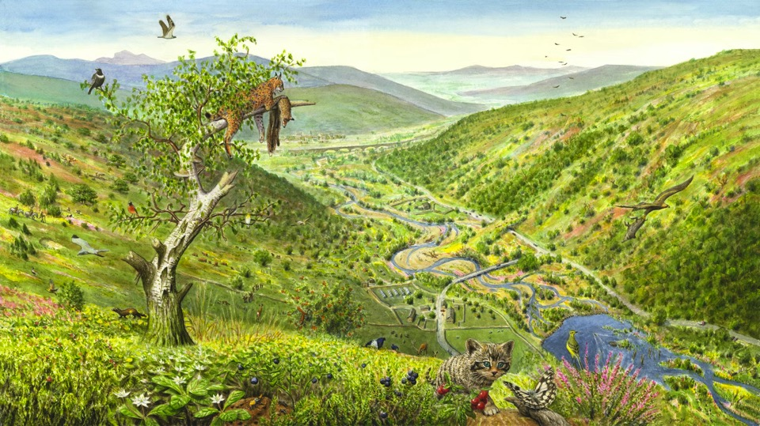
Can we restore it back to what it was like before?
We call this wilding

Slide 24
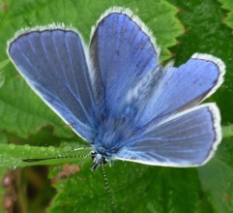
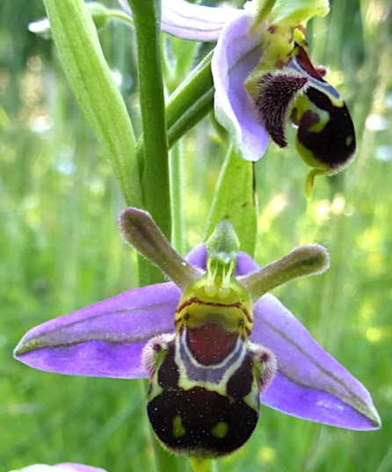
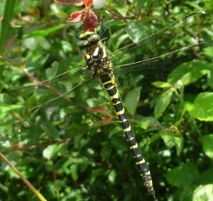
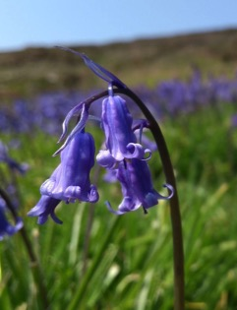
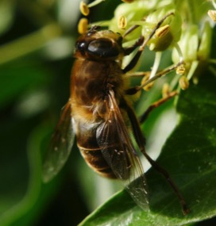

Slide 25
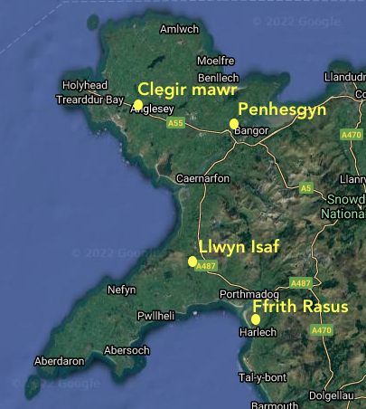
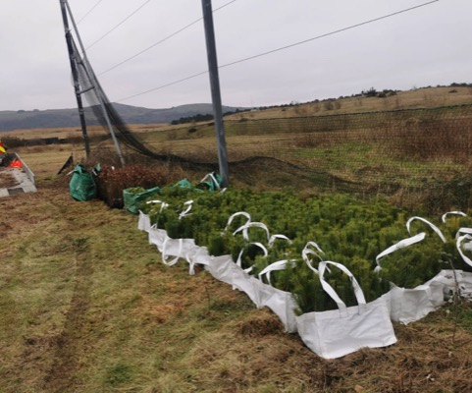
There are 4 landfill sites in north Wales being rewilded

Slide 26
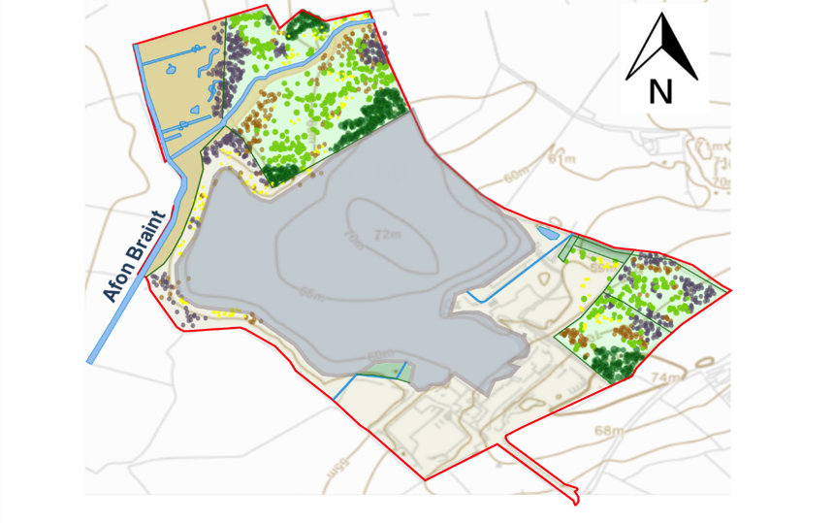
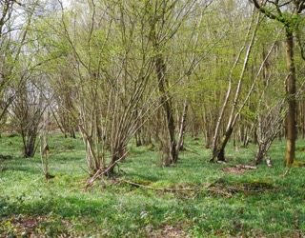
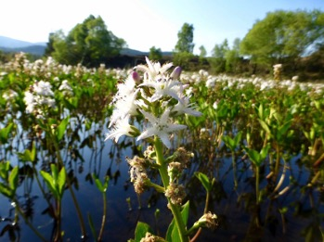
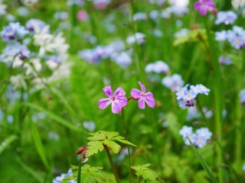
Designing the new habitats

Slide 27
Where do you fit in?
Join the school Eco council
Start reducing household waste
Do a school ground survey - STEM
Create a habitat in your school grounds
Make a bug hotel
Share your experiences on social media #greenrevolution

Slide 28
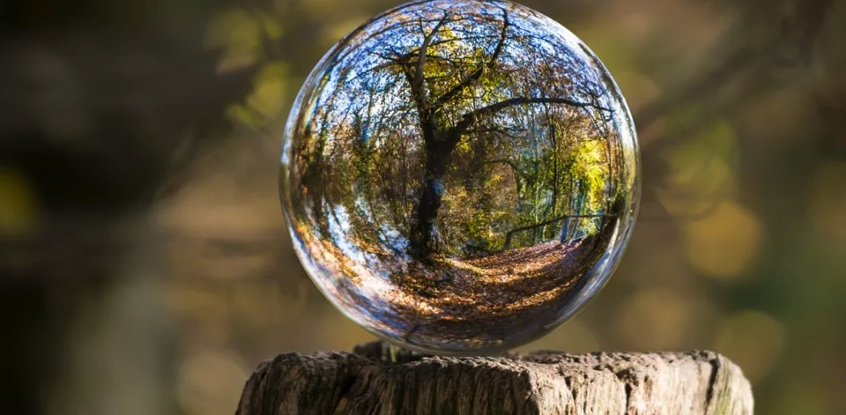
Reimagine…..

Slide 29
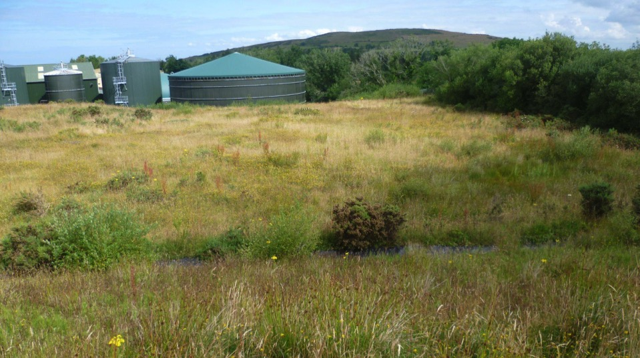
For more information & ways to get involved contact
jim@natureswork.co.uk

